Slide 1
Programming with B4X
Lesson 17 – Files
Anywhere Software
March 2021

Slide 2
Today you will learn
What is a file?
Basic Operations with maps
For Each command

Slide 3

What is a file?
A collection of data
similar content
stored in a permanent space
Notes:
File we call a collection of data with similar content that is stored in the permanent space usually on the computer's hard disk. It is one of the most important features of programming languages since while all caching is done with central memory, after an application is completed its data should already be stored permanently.

Slide 4
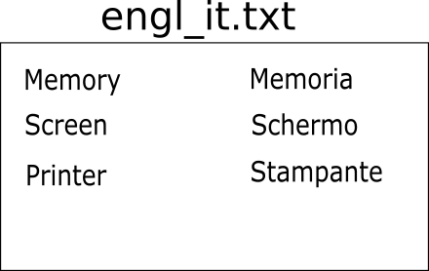
What is a file
Files can be
or
databases
simple
Notes:
Generally, the files are divided into databases and simple files which we will examine.

Slide 5
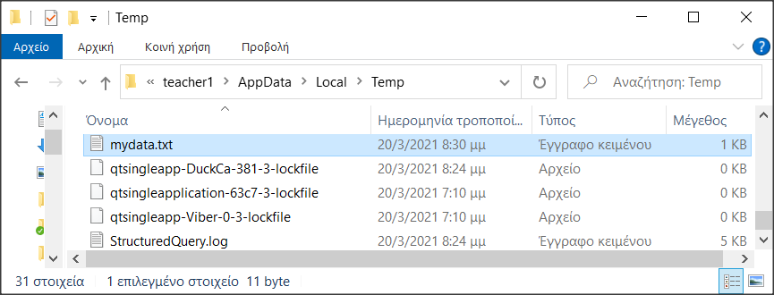
Storage Folders
Folders
Depends on Operating System
Notes:
Each operating system has many different folders to store applications data or other files. In order for B4J to work with files independently of the operating system, it uses keywords that refer to a specific type of folder.

Slide 6
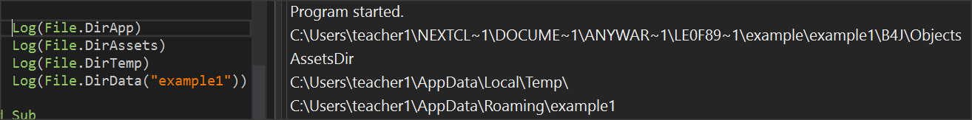
Storage keywords
File.DirAssets
xui.DefaultFolder
File.DirData
File.DirApp
File.DirTemp
Notes:
File.DirAssets
Includes files contained in the application files folder that have been added by B4J file management during the development phase of an application. These files are read-only and no file can be added while the application is running. Files are usually written by the developer so that after installing the application they can be copied to other folders for use.
xui.DefaultFolder
Returns the folder where the application data is stored like File.DirData do. You are first required to call the SetDataFolder command once before using it.
xui.SetDataFolder(AppName As String)
File.DirData
Returns the folder where the application data is stored and is suitable for creating files and storingdata.
In a Windows environment, returns the "user data folder" that is usually in the path
C:\Users\[user name]\AppData\Roaming\[AppName]
On non-Windows operating systems, returns the folder where the applica-tion is installed
File.DirApp
Returns the folder where the application is installed. In Windows, this folder is usually Program Files and is read-only.
File.DirTemp
Returns the Temporary Files folder.
You can use the above commands in combination to declare a new folder within the previous ones. For example,
Private strFolder As String = File.DirTemp & “lesson17\”
Log(strFolder)
Displays C:\Users\<user name>\AppData\Local\Temp\lesson17\

Slide 7
File Commands
Create folders
File.MakeDir (Parent As String, Dir)
File.MakeDir(File. DirTemp, “lesson17")
Check file existence
File.Exists (Dir As String, FileName As String)
Private fn as String = “mydata.txt”
If File.Exists(File.DirTemp, fn) Then
Log("File " & fn & " Exists")
Else
Log("There is no File: " & fn)
End If
Notes:
Create folders
You can create a new folder with the
File.MakeDir (Parent As String, Dir)
File.MakeDir(File. DirTemp, “lesson17")
Creates a folder named lesson17 within C:\Users\teacher1\AppData\Local\Temp\ of the previous example.
Check file existence
Before you use a file, usually the first task to do is to check for existence. The command is
File.Exists (Dir As String, FileName As String)
And returns truth or lie that you can control it with a command if.
Private fn as String = “mydata.txt”
If File.Exists(File.DirTemp, fn) Then
Log("File " & fn & " Exists")
Else
Log("There is no File: " & fn)
End If

Slide 8
Create a file
File.OpenOutput (Dir As String, FileName As String, Append As Boolean)
Private fn as String = “mydata.txt”
File.OpenOutput(File.DirTemp, fn, True)
Notes:
If the file does not exist then it is created.
The logical value True or False in the third parameter refers to whether the file is opened for write by erasing the older data or will add to existing records.

Slide 9
Writing and reading data
String-type variables
File.WriteString (Dir As String, FileName As String, Text As String)
Private fn As String = “mydata.txt”
Private msg As String = "Hello World"
File.WriteString(File.DirTemp, fn, msg)
File.ReadString (Dir As String, FileName As String) As String
Private fn As String = “mydata.txt”
Private strFileContent As String
strFileContent = File.ReadString(strFolder, fn)
Notes:
You can write or read data from one word to more complex structures such as lists and maps.
Writes a string variable to the file. Attention the file is created from the beginning even if it already existed. So, its data is deleted.
For a file that already exists you can read its data and transfer it to a string variable with the command

Slide 10
Writing and reading data
Lists
File.WriteList(Dir As String, FileName As String, List As List)
File.WriteList(strFolder, "mydata.txt", List1)
File.ReadList (Dir As String, FileName As String)
List1 = File.ReadList(File.DirRootExternal, " mydata.txt")

Slide 11
Writing and reading data
Maps
File.WriteMap(Dir As String, FileName As String, Map As Map)
File.WriteMap(File.DirInternal, “file.txt", map1)
ReadMap(Dir As String, FileName As String)
map1 = File.ReadMap(File.DirInternal, "file.txt")

Slide 12

Thank you!!!
Images:
Photo by Christina Rumpf on Unsplash

